Slide 1
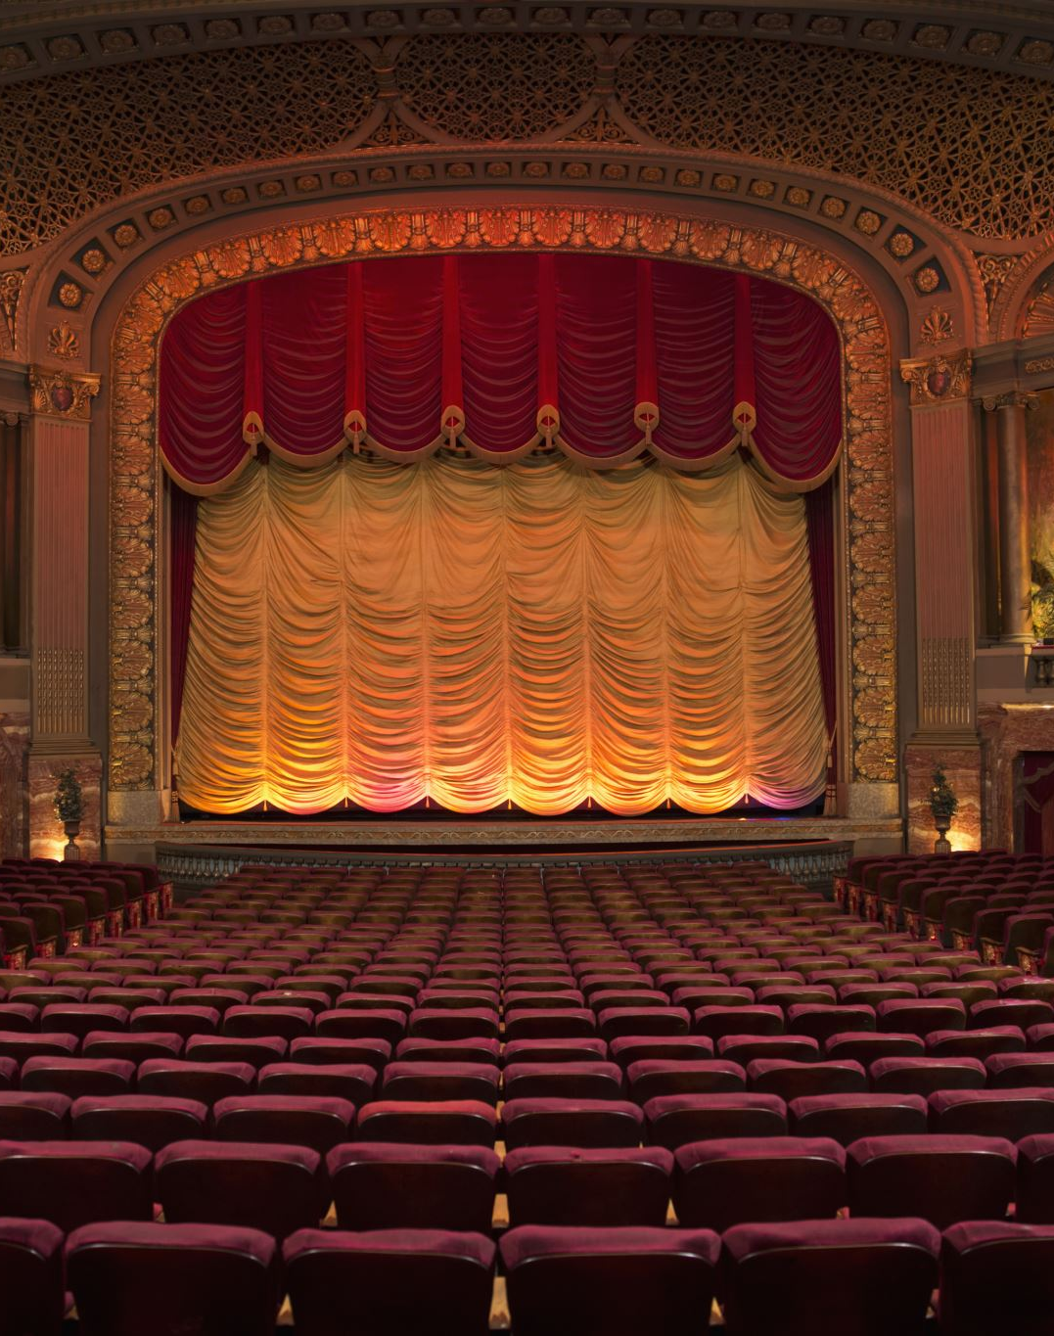
Utopia and Dystopia in the Theatrical Act
Week 6
Modern Theories : Ruth Levitas, Lucy Sargisson, Jill Dolan, David Harvey
TAZ, Burning Man, Immersive Theatre

Slide 2
Ruth Levitas: Hope, The Education of Desire and the Imaginary Reconstitution of Society
What is Utopia for?
Everything that reaches to a transformed existence can be considered to have a utopian aspect. (Bloch: fairy tales, myths, theatre, architecture, music, new clothes, religion). Begins with ‘wishful thinking’.
Utopian models holistic, imaginary, critical, normative, prescriptive and future orientated. The imagining of a reconstituted society, society imagined otherwise. Utopia as Method in order to effectively address problems: international poverty, social inclusion/exclusion, sustainable futures.

Slide 3
Utopia as Method : Ruth Levitas
Three Modes:
Analytical/archaeological: the good society open to public critique, inclusion, social relationships, quality of life, poverty, inequality
Constructive/architectural: Creating viable alternatives (means/goal)
Ontological: The education of desire, different selves.
All modes must be multiple, provisional and reflexive.

Slide 4
Utopian Transgression: Lucy Sargisson
Against Binaries and Dualisms
Utopian Bodies and the Politics of Transgression, 2000.
Transgression of boundaries utopian method: self/other, difference, codes and norms.
Fool’s Gold, 2012: Utopian Desire: Criticism and Creativity at heart.
Analytical political thought or fantasy/escape (if one part missing).
Core terms: Authorship (whose utopia – individual or group or leader), context (what is context it occurs: hierarchical, egalitarian, consensual, co-operative, anarchist, exploitative, capitalist), intent (what does it seek: realization, perfection, exploration, oppositional, critique, experimental). Prime goal to change way we think, not so much helping to change the structural contexts in which beliefs and practices are produced and re-produced (Levitas). Utopia as catalyst for change.

Slide 5
Transgression of Binaries
Contemporary Feminist Utopianism, 1996
First, it issues from political dissatisfaction and offers political critique. Second, it articulates estrangement and offers an alternative perspective from a new space. Third, it is creative and imaginative. Fourth, it has subversive and transformative potential (3). As a result, transgressive utopian thought breaks the rules that support boundaries; it questions traditional paradigms; and creates new space where new political and conceptual ideas may thrive.
Three of the most important binaries which feminist utopian thought seeks to transgress are between: self/other; spirit/matter; and generic conventions which can enact political desires

Slide 6
Υπέρβαση/Παράβαση Δυαδικών Σχέσεων
(Lucy Sargisson)
Τρία από τα πιο σημαντικά δίπολα που η φεμινιστική ουτοπική σκέψη επιδιώκει να παραβιάσει είναι μεταξύ: εαυτός/άλλος· πνεύμα/ύλη· και γενικές συμβάσεις που μπορούν να θεσπίσουν πολιτικές επιθυμίες.
Πρώτον, πηγάζει από την πολιτική δυσαρέσκεια και προσφέρει πολιτική κριτική. Δεύτερον, αρθρώνει την αποξένωση και προσφέρει μια εναλλακτική προοπτική από έναν νέο χώρο. Τρίτον, είναι δημιουργική και ευφάνταστη. Τέταρτον, έχει ανατρεπτικές και μετασχηματιστικές δυνατότητες. Ως αποτέλεσμα, η υπερβατική ουτοπική σκέψη σπάει τους κανόνες που υποστηρίζουν τα όρια, αμφισβητεί τα παραδοσιακά μοντέλα και δημιουργεί νέο χώρο όπου νέες πολιτικές και εννοιολογικές ιδέες μπορούν να ευδοκιμήσουν.

Slide 7
Utopia in Performance: Finding Hope at the Theatre, Jill Dolan, 2005
Articles | The Feminist Spectator (princeton.edu)
Emotional, visceral, social connection felt at the theatre – νot what might a better world look like, but feel like – and motivate us for change through hopeful utopian sentiment. Finding utopia in Performance is idiosyncratic, spontaneous, unpredictable.
Performance provides a forum for connectedness, for being human together, for feeling love, hope and commonality in ‘particular and historical ways’ (not universal and transcendent). To describe and capture fleeting moments of a better world. Performance inspires audiences to feel alliances with each other. Radical Humanism.
Utopia in Performance: Finding Hope at the Theater - Jill Dolan - Google Books (see Carslon quote) Civic participation and emotional belonging.

Slide 8
Utopian Performance, part 2
Utopian Performatives describe small but profound moments in which performance calls the attention of the audience in a way that lifts everyone slightly above the present into a hopeful feeling of what the world may be like, if every moment of our lives were as emotionally volatile, generous, aesthetically striking and intersubjectively intense (5). “…the potential of different kinds of performance to inspire moments in which audiences feel themselves allied with each other, and with the broader, more capacious sense of a public, in which social discourse articulates the impossible, rather than the insurmountable obstacles to human potential.” (2) “The aesthetics of these performances lead to both affective and effective feelings and expressions of hope and love not just for a partner, as the domestic scripts of realism so often emphasize, but for other people, for a more abstracted notion of “community” or for an even more intangible idea of “humankind…the possibility of the politics of transformation”. (2)

Slide 9
Function of Utopian Performatives: Utopia as process of spending time
Utopian performatives persuade us that beyond this now of material oppression and unequal power relations lives a future that might be different, one whose potential we can feel by the promise of a present that gestures towards the future (7). They rehearse civic engagement. (Boal and Brecht). Imagination, Dreams, Desires
Document performance’s emotional efficacy as a way to think about its social potential (15)
Theatre: A space of desire, longing, loss
Οι ουτοπικές επιτελέσεις μας πείθουν ότι πέρα από αυτό το τώρα της υλικής καταπίεσης και των άνισων σχέσεων εξουσίας ζει ένα μέλλον που μπορεί να είναι διαφορετικό, ένα μέλλον του οποίου τις δυνατότητες μπορούμε να νιώσουμε με την υπόσχεση ενός παρόντος που χειρονομεί προς το μέλλον. Προβάρουν τη συμμετοχή στα κοινά.

Slide 10
Utopia, present and future
The ‘Utopian Performative’ springs from a complex alchemy of form and content, context and location, which take shape in moments of utopia as doings, as process, as never finished gesture toward a potentially better future (8). Dolan
Performance’s simultaneity, its present-tenseness, uniquely suits it to probing the possibilities of utopia as a hopeful process that continually writes a difference, better future...its spatiality often anchors it to an imagined place, a “what if” of matter and expression. Performance always exceeds its space and its image, since it lives only in its doing, which is imagining, in the good no-place that is theatre (13)…Spectators, imagine, together, the affective potential of a future in which this rich feeling of warmth, even of love, could be experienced regularly and effectively outside the theatre.

Slide 11
Utopian Theatre?
Theatre becomes a privilege, intimate area of human experience within which one can demand…that the impossible be achieved /experienced here and now – the impossible - a sense of unity between what is usually divided in our daily life, the material and immaterial, the human body and spirit. Mortality and infinity – the absolute. Joseph Chaikin, Open Theatre
Το θέατρο γίνεται ένα προνόμιο, ένας οικείος χώρος της ανθρώπινης εμπειρίας μέσα στον οποίο μπορεί κανείς να απαιτήσει... Το αδύνατο να επιτευχθεί / βιωθεί εδώ και τώρα - το αδύνατο - μια αίσθηση ενότητας μεταξύ αυτού που συνήθως χωρίζεται στην καθημερινή μας ζωή, του υλικού και του άυλου, του ανθρώπινου σώματος και πνεύματος.

Slide 12
Utopian and Dystopian Drama: The Plot of the Future: Utopia and Dystopia in Modern Drama, 1991
“Plays that revived interest in the future as a dramatic theme and as a chosen time setting of dramatic action.” 1991, (2)
“Theatre succeeds when it presents its utopian arguments as a blueprint, open to opposition, rather than depicting the consequences of their implementation.” 1995, (61)
Utopia is, by its very nature, without conflict-a state of stasis, harmony and balance. These are not ingredients for exciting theatre, which is always based on conflict, opposition and contradiction or at least tension. 1995, (16)

Slide 13
Ernst Bloch and his followers: Herbert Marcuse (The Aesthetic Dimension: Towards a Critique of Marxist Aesthetics, 1978) and David Harvey (Spaces of Hope, 2009)
The Principle of Hope: The Utopian Function of Art and Literature: instances of “anticipatory illumination” which evade our efforts to apprehend them directly..utopia is a mode of our being”
Hope knows itself as the ‘utopian function‘. Its contents are first represented in ideas, and essentially in those of the imagination. Bloch speaks of such imaginative ideas as extending, “in an anticipating way, existing material into the future possibilities of being different and better”.
Role of Imagination crucial: not wish-fulfilment but artistic expression: music, drama, art
Herbert Marcuse following Bloch: “Art as an arena in which an alternative world can be expressed—not in a didactic, descriptive way as in traditional ‘utopian literature’, but through the communication of an alternative experience.”

Slide 14
David Harvey: Spaces of Hope (2009)
Part 1: Spatiotemporal Utopias
Spatiotemporal utopianism/reaction to problems in special form or temporal process.
Imaginative spatial play to achieve specific social and moral goals converted to potentially endlessly open experimentation with the possibilities of spatial form, ie. Exploration of different modes of collective living, gender relations, the relation to nature, production/consumption styles). Exploration of emancipatory strategies. Authoratianism/totalitarianism? (because of closure)

Slide 15
David Harvey, Spaces of Hope, Part 2: Dialectical Utopianism
Process-Orientated Utopias, (free)market exchange, Materialized Utopias of process cannot escape problem of closure.
Free-flowing processes become instantiated in structures, in institutional, social, cultural and physical realities that acquire a relative permanence, fixity, and immovability.
Contradictions of Capitalist Utopia: material well-being/consumerism promise of rights, freedoms, democracy, co-option of resistance

Slide 16
Spaces of Hope, Part 3:
Either/or vs both/and
Task: to define an alternative not in terms of static special forms or even of some perfected emancipatory social process. I.e., a spatiotemporal utopianism/dialectical utopianism, rooted in our present possibilities and simultaneously pointing towards different trajectories for human, uneven, geographical developments.
The challenge is to develop language materially grounded in social and ecological conditions which emphasizes possibilities and alternatives for human action through the will to create. Political-economic alternatives to class-bound capitalist system.
Issues: conservations of micro-habitats, ecological restoration projects, urban design, fossil fuel utilization, resource exploitation patterns, livelihood protections, sustenance of geographically specific cultural forms, life enhancement at local and global level.

Slide 17
Spaces of Hope, Reviews
Interplay between individuals and the environment ‘Imaginative special play to achieve specific social and moral and goals – potentially endlessly open experimentation with the possibility of spatial forms. This permits the exploration of a wide range of human potentialities (different modes of collective living, gender relations, production/consumption, in relation to nature.
Beyond Marx’s contradictions in society.

Slide 18
TAZ : Temporary Autonomous Zone
E.g. Burning Man, Nevada
Apogaea, Colorado (far from Earth)
Burning Flipside, Austen, Texas, ‘Pyropolis’
Nowhere, Aragon, Spain, Nowhere (event) – Wikipedia
Transformus, West Virginia, City called ‘Mysteria’ (11th Principle: Consent) 2004
Firefly Arts Collective, Vermont, USA

Slide 19
Burning Man : Festival, Ritual or Utopia?
Ceremony: Burning wooden effigy of man night before Labour Day, Larry Harvey, 1986-8 San Francisco/1991 - Black Rock City (temporary), Nevada (Dessert), 9 days. 20 + thousand, ‘why not?’ inspires annual theme -1996. Last day burning of ‘The Temple’
Attendees create all art, activities and events, performances, multi-media. Radical Self-Expression
Ten principles: participation, radical inclusion, de-commodification, self-reliance, self-expression, communal effort, civic responsibility, ‘leave no trace’, immediacy, gifting

Slide 20
Immersive Theatre: ‘The Burnt City’ (Punchdrunk)
Homer’s Iliad in two parts: The Greek camp and Troy
Large scale, immersive, detailed props, dance, music
Individual experience, affect, senses, multiple visits
Audience participation but masks mandatory.
Transgression of boundaries: No fourth wall, no stage audience/stage, Punchdrunk 'The world's leading immersive theatre company' – GQ Magazine

Slide 21
DiY Culture: ‘Do it Yourself’ Culture
Early 20th / 6th BCE, Basilicata
Reaction to: academic and economic specialization: Design, create, customize, repair without special training. Critical Making. The Maker-Culture/self-made culture
DiY as venue for holistic engagement/marketplace motivations (economic, lack of product or quality, /identity enhancement (craftmanship, community, uniqueness)
Hackerspace, Solarpunk, Infoshops, Hackerspace, musicians, mix-tapes, RRR, crafts (greeting cards, self-publish, clothes-haute couture?) Utopia as Process?
Artists against mass culture and mass production/emphasis on man-made
Social Idea: sharing ideas, designs, techniques, methods, projects online or in person. Ethic of self-sufficiency (no need for paid expert) because anyone can perform a variety of tasks. Education system?

Slide 22
Utopia, Method, Vision, 2007
Tom Moylan and Raffaella Baccolini
Be realistic - Demand the impossible! David Bell – utopia in the here and now/continual change and rethinking, ‘ambiguous consistency’, ‘immanent and prefigurative’, ‘micro-utopias’. Ουτοπία στο εδώ και τώρα/συνεχής αλλαγή και επανεξέταση, «διφορούμενη συνέπεια», «έμφυτη και προεικονιστική», «μικρο-ουτοπίες». Inter-action between human and non-human animals or more than-
Co-optation (οικειοποίηση/εργαλειοποιηση) of Utopia by capitalism.
Utopian subjects (Moylan)
Nostalgia: for ideal past that did not exist. Memory manipulation (conservative) or improved version of past for ideals of future (creative).

Slide 23
Conclusion
Christiania, Denmark vs The Amish of Pennsylvania
Function vs Vision/Temporary vs Permanent / Process vs Perfection
Utopia or Ideology? (truth vs lies). Is/are utopia(s) dangerous?
Eutopia: at what cost? Repositories of our fears and hopes, individual and collective. Desire to impose our utopia on others leads to dystopia.
Sargent: We must choose Utopia: Choose the belief that the world can be radically improved; we must dream socially, we must allow our dreams to affect our lives. We must commit utopia. “ Utopias are generally oppositional, reflecting, at the minimum, frustration at things as they are and the desire for a better life.”

