Slide 1
Καινοτομία και Επιχειρηματικότητα
Προστασία Διανοητικής Ιδιοκτησίας
Αναπλ. Καθ. Ευάγγελος Σιώκας

Slide 2
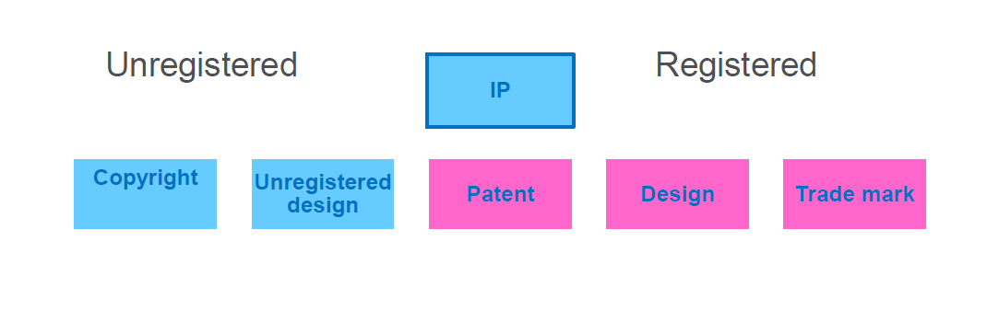
Εισαγωγικά
Κάθε επιχείρηση ή Πανεπιστήμιο διαθέτει στοιχεία διανοητικής ιδιοκτησίας
Κάποια εξ αυτών δεν μπορούν να καταγραφούν / καταχωρηθούν άλλα καταχωρούνται και παίρνουν τη μορφή πατέντας, σχεδίου ή εμπορικού σήματος
Πηγή: European Patent Office, IP teaching kit

Slide 3
Διανοητική ιδιοκτησία (intellectual property)
Nομοθεσίες σύμφωνα με τις οποίες παραχωρούνται αποκλειστικά δικαιώματα εκμετάλλευσης στους δικαιούχους άυλων αγαθών, τα οποία είναι προϊόντα του ανθρώπινου νου
Τι μπορεί να προστατευτεί:
  Οι εφευρέσεις.
  Οι καινοτομίες προϊόντων ή διαδικασιών
  Τα βιομηχανικά σχέδια και υποδείγματα.
  Τα σήματα.
  Οι τοπογραφίες ημιαγωγών - μικροτσίπ.
  Οι γεωγραφικές ενδείξεις και ονομασίες προέλευσης.
  Η πνευματική ιδιοκτησία και τα συγγενικά δικαιώματα
Industrial property
  Copyright and related rights

Slide 4
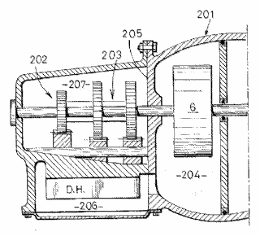




Overview of intellectual property
Legal right
What for?
How?
Patents
New inventions
Application and examination
Copyright
Original creative or artistic forms
Exists automatically
Trade marks
Distinctive identification of products or services
Use and/or
registration
Registered designs
External appearance
Registration*
Trade secrets
Valuable information not known to the public
Reasonable efforts to keep secret

Slide 5
Δίπλωμα ευρεσιτεχνίας
Το Δίπλωμα Ευρεσιτεχνίας είναι ένας τίτλος που χορηγείται από αρμόδια αρχή και δίνει στον κάτοχό του το αποκλειστικό δικαίωμα της παραγωγής και οικονομικής εκμετάλλευσης της εφεύρεσης στην οποία αναφέρεται.
Το Δίπλωμα Ευρεσιτεχνίας ισχύει στο κράτος για το οποίο χορηγήθηκε, και εκτός από ελάχιστες εξαιρέσεις κάθε Δίπλωμα Ευρεσιτεχνίας ισχύει σε ένα κράτος. Επίσης το Δίπλωμα Ευρεσιτεχνίας έχει χρονική διάρκεια ισχύος 20 έτη από την ημερομηνία, που κατατέθηκε η αίτηση για τη χορήγησή του.
Προϋποθέσεις:
  Πρωτοτυπία
  Προϊόν εφευρετικής δραστηριότητας
  Δυνατότητα εφαρμογής στο βιομηχανικό τομέα

Slide 6
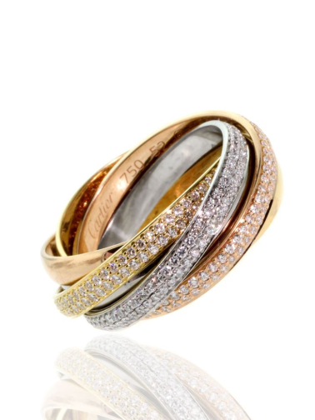

Βιομηχανικά σχέδια και υποδείγματα – Industrial Designs
Σχέδιο ή υπόδειγμα είναι η εξωτερικά ορατή μορφή ενός προϊόντος ή μέρους αυτού, που απαρτίζεται από ένα σύνολο χαρακτηριστικών, ως γραμμές, περιγράμματα, σχήματα, χρώματα κ.α.
              Καινοτόμο
                Έχει ατομικό χαρακτήρα
                Η όψη του δεν ορίζεται αποκλειστικά από τη λειτουργία του
                Δεν αντιτάσσεται της ηθικής και της δημόσιας τάξης

Slide 7
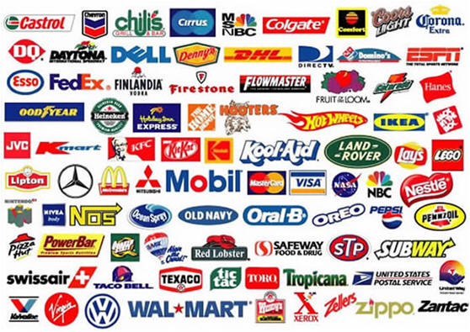
Εμπορικά σήματα – trade marks
Kάθε στοιχείο, ικανό να διακρίνει τα προϊόντα ή τις υπηρεσίες ενός προσώπου - φυσικού ή επιχείρησης - από εκείνα άλλων προσώπων.
Τι μπορεί να αποτελέσει εμπορικό σήμα:
  λέξεις,
  ονόματα φυσικών ή νομικών προσώπων,
  ψευδώνυμα,
  απεικονίσεις,
  σχέδια,
  γράμματα, αριθμοί,
  ήχοι,
  σχήματα προϊόντων ή συσκευασίες αυτών.
Εμπορικό σήμα # Εμπορική επωνυμία
προϊόν επιχείρηση

Slide 8
Πνευματική ιδιοκτησία - Copyright
Προστατεύει πρωτότυπα λογοτεχνικά, καλλιτεχνικά και επιστημονικά πνευματικά δημιουργήματα με οποιαδήποτε μορφή, όπως επίσης και έργα ψηφιακής τεχνολογίας, βάσεις δεδομένων και πολυμέσα.
«κάθε πρωτότυπο δημιούργημα λόγου τέχνης ή επιστήμης, που εκφράζεται με οποιαδήποτε μορφή» π.χ.
  Λογοτεχνικά και θεατρικά
  Μουσικά και καλλιτεχνικά
  Ταινίες και μουσικές ηχογραφήσεις
  Τυπογραφία εκδομένων βιβλίων και μουσικής
  Αναμεταδόσεις και καλωδιακά προγράμματα
  Φωτογραφίες
Προϋποθέσεις: ατομικότητα και ενσωμάτωση σε αισθητό υπόστρωμα (συνήθως υλικό).
Προστατεύεται η μορφή, η έκφραση και όχι η ιδέα ή η πληροφορία καθαυτή.

Slide 9
Σχετικά με το λογισμικό
Προστατεύεται με copyright.
Η προστασία δεν καλύπτει τους αλγόριθμους και γενικότερα τις ιδέες και τις αρχές, στις οποίες βασίζεται οποιοδήποτε στοιχείο προγράμματος ηλεκτρονικού υπολογιστή, περιλαμβανομένων και εκείνων στις οποίες βασίζονται τα συστήματα διασύνδεσής του.
Προϋποθέσεις: εφόσον είναι πρωτότυπα, σύμφωνα με τις αρχές που θέσπισε η κοινοτική Οδηγία 91/250 και στις οποίες προσαρμόστηκε η ελληνική νομοθεσία (άρθρο 2 παρ.3 του ν.2121/1993).
Χορηγούνται διπλώματα για εφευρέσεις που εμπεριέχουν λογισμικό ή για εφευρέσεις, που εφαρμόζονται σε ηλεκτρονικό υπολογιστή – computer implemented inventions

Slide 10
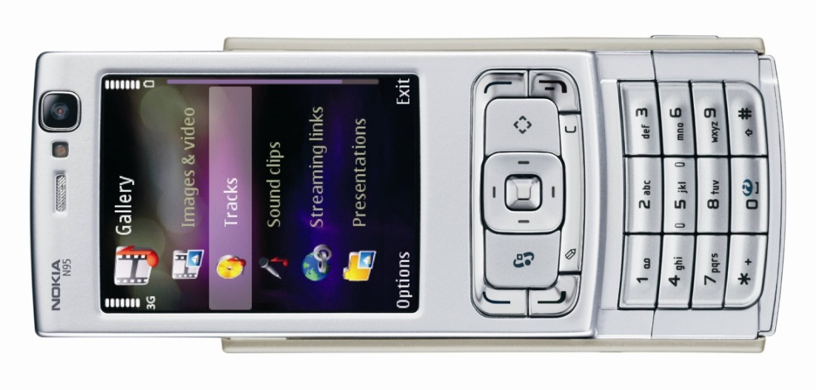
Some IP found in a mobile phone
Trade marks:
Made by "Nokia"
Product "N95"
Software "Symbian", "Java"
Patents:
Data-processing methods
Semiconductor circuits
Chemical compounds
…
Copyrights:
Software code
Instruction manual
Ringtone
…
© Nokia
Trade secrets:
?
Designs (some of them registered):
Form of overall phone
Arrangement of buttons in oval shape
Three-dimensional wave form of buttons
…

Slide 11
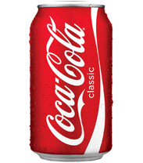

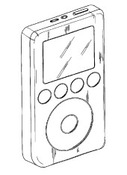
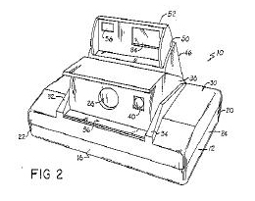
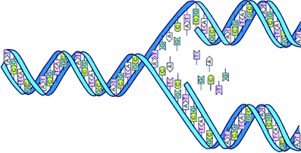
Examples of valuable intellectual property
Optional
Harry Potter
Coca-Cola®
Apple® iPod®
Instant camera
DNA copying process

Slide 12
The four main pillars of IP management
Implementation
Tools, processes, recommendations, guidelines
→ increase in quality, integrity, transparency and efficiency
Creating opportunities
Evaluation
IP protection
Exploitation
Awareness creation
Teaching & training
IPR support
Technology scouting
Micro/seed-funding
Innovation awards
Business strategies
Licence agreements
Spin-outs
Assignments/sales
12

Slide 13
Rights conferred by the patent
Prevent others from making, using, offering for sale, selling or importing infringing products in the country where the patent was granted
Sell these rights or conclude licensing contracts
For up to 20 years from the date of filing of the patent application
The patent does not grant the right to use the invention!
A patent search
is indispensable!!!

Slide 14
What does a patent look like?
Bibliographic information
  Inventor, proprietor, date of filing, technology class, etc.
Abstract
  Around 150 words as a search aid for other patent applications
Description
  Summary of prior art (i.e. the technology known to exist)
  The problem that the invention is supposed to solve
  An explanation and at least one way of carrying out the invention
Claims
  Define the extent of patent protection
Drawings
  Illustrate the claims and description
Notes:
Bibliographic information:
Who applied for the patent, who invented it, etc. - the technology class is very useful for searching (discussed later)
Abstract:
Useful to search for patents and quickly browse through search results.
Description:
Contains a full and detailed description of the invention so that others can understand and replicate it.
Claims:
Define the scope of patent protection.
Drawings:
Help with understanding and interpreting the claims and the description.

Slide 15
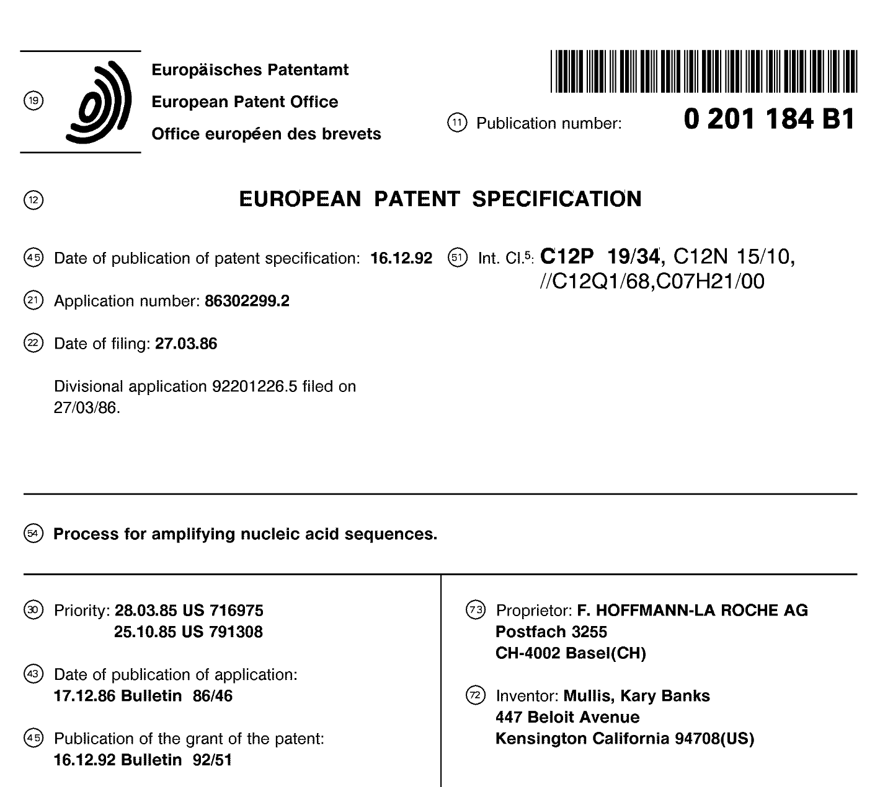
Front page of a patent as published

Slide 16
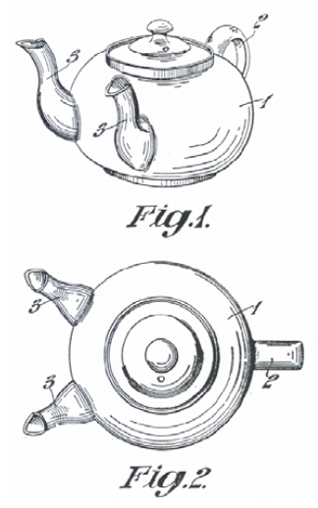
Structure of the description
Prior art
  Teapot with one spout
Drawback of prior art
  Time-consuming
Problem to solve
  Reduce filling time
Solution
  Provide a second spout
Advantage of the invention
  The time needed to fill multiple
  cups is reduced

Slide 17
What can be patented at the European Patent Office?
Inventions that are…
  new to the world (no previous public notice)
  inventive (i.e. not an "obvious" solution)
  susceptible of industrial application
NOT:
  Mere ideas not reduced to practice
  Software as such
  (but algorithms that achieve technical results)
  Business methods
  Medical therapies, plant varieties, etc.
  …
See Articles 52 and 53 EPC in
http://www.epo.org/patents/law/legal-texts/epc.html
Notes:
This slide refers to patent applications filed with the European Patent Office (under the European Patent Convention, or EPC).
The patent will cover only those aspects of your invention that are new and inventive.
Note: The USA has a one-year grace period – you can apply for a US patent up to one year after having disclosed the invention to the public.
Inventions must have an industrial application in order to be patentable. However, the patent office does not examine whether the invention is of economic value. This requirement is only very rarely a practical hurdle for patent applications (exceptions exist for example in some fields of biotechnology).

Slide 18




What not to do when considering filing a patent application
No publication prior to filing
e.g. no article, press release, conference presentation/poster/proceedings or blog entry
No sale of products incorporating the invention prior to filing
No lecture or presentation prior to filing
except under a non-disclosure agreement (NDA)
Seek professional advice soon!
File before others do!
NDA

Slide 19
Where to apply for a patent
National patent offices
  National patent valid only in the country where it is granted
  Non-residents can also apply for a patent
  One year of "priority" for subsequent applications
European Patent Office
  A European patent is equivalent to national patents in the countries where it is granted (the applicant chooses the countries)
Via the Patent Cooperation Treaty
  Just one application for up to 141 countries
  After the initial application phase, the international application leads to multiple national patent examination procedures
  Decisions with cost implications can be delayed until 30-31 months after filing (e.g. choice of countries to file in)
There is no such thing as an international patent!

Slide 20
The patent procedure at the EPO
Search
report
Publication
of application
Publication
of grant
Opposition
period expires
Application
18 months
Withdraw?
Approx. 4-5 years
9 months

Slide 21
Advantages and disadvantages of patenting
Advantages
Disadvantages
Exclusivity enables investment and higher returns on investment
Strong, enforceable legal right
Makes invention tradable (licensing)
Reveals invention
to competitors
(after 18 months)
Can be expensive
Patent enforceable only after grant (this can take
4-5 years)
Notes:
Patent applications are always published 18 months after the date of filing, when they become available on free internet databases.
Patent applications may also offer a certain amount of protection, as competitors may well assume that the patent will be granted and might thus be discouraged from investing in commercialising a potentially infringing product.
Furthermore, some legal protection is also offered (see background notes).
Notes:
While patents are generally considered to be very strong and enforceable rights, even granted patents can be found to be invalid in court proceedings (i.e. although a patent office might have granted a patent in the first place, judges might later find that they should not have done so).
Enforcing patent rights may mean going to court, and this can be costly.

Slide 22
Alternatives to patenting
Information disclosure (publishing)
Cheap
Prevents others from patenting the same invention
Does not offer exclusivity
Reveals the invention to competitors
Secrecy (creating a trade secret)
Cheap (but there is the cost of maintaining secrecy)
Does not reveal the invention
No protection against reverse-engineering/duplication of invention
Difficult to enforce
"Secrets" often leak quite fast
Do nothing
No effort required
Does not offer exclusivity
Competitors will often learn details
Notes:
Information disclosure:
the invention can be published in any newspaper, magazine, journal, book or public prior art database.
publication prevents others from applying for a patent on the same invention and will thus keep the invention "patent-free" (however, other prior patents might effectively block its use).
Trade secrets:
frequently used, especially for inventions that do not qualify for patent protection and for production processes that cannot be reverse-engineered by analysing the end product. In the latter case, patent infringement would be very difficult to prove and thus patents might be ineffective.
on average, detailed technological information leaks out within a year.
Additional, complementary means of protecting inventions: lead-time advantages (time-to-market), learning curve effects, network effects (i.e. creating a user base), customer relations, etc. In surveys, these options are found to be at least as important as patent protection and other legal instruments.

Slide 23
How patents are used
Protecting products and processes
  Increasing turnover and profits
  Attracting investors
Licensing
Cross-licensing
Blocking competitors
Building reputation
…
Not used

Slide 24
Patent management
Patent strategy
  Offensive/defensive
  Internationalisation
  Kind of exploitation: licensing or own use
Patent information
  Keep abreast of technology
  Avoid infringing patents
  Understand the competitive landscape
Communication
  Compile convincing evidence that your patents are valuable
  Inform investors and banks, clients and prospective employees
Maintenance
  Pay renewal fees, observe deadlines
  Strengthen important patents and get rid of ones with no value

Slide 25
25% of all R&D efforts ...
… are wasted each year on inventions that have already been invented.
Don't start your R&D until you have done a search!

Slide 26
US-A-1833019
GB-A-2365393
Notes:
Reinventing the wheel - literally
Problem: excessive wear (or even explosion) of aircraft wheels due to high acceleration when touching the ground.
Proposed solution: small pockets on the side of the tires that make the wheel spin in the wind without the need for an additional electrical motor.
Patent already applied for in 1929!

Slide 27
Much information only available in patents
Published elsewhere
Published
in patents
80% found only in patents!
Where do secretive competitors publish their R&D?

Slide 28
Solutions found in patent documents
90%
Free to use
10%
Protected
You can find many great solutions for free!

Slide 29
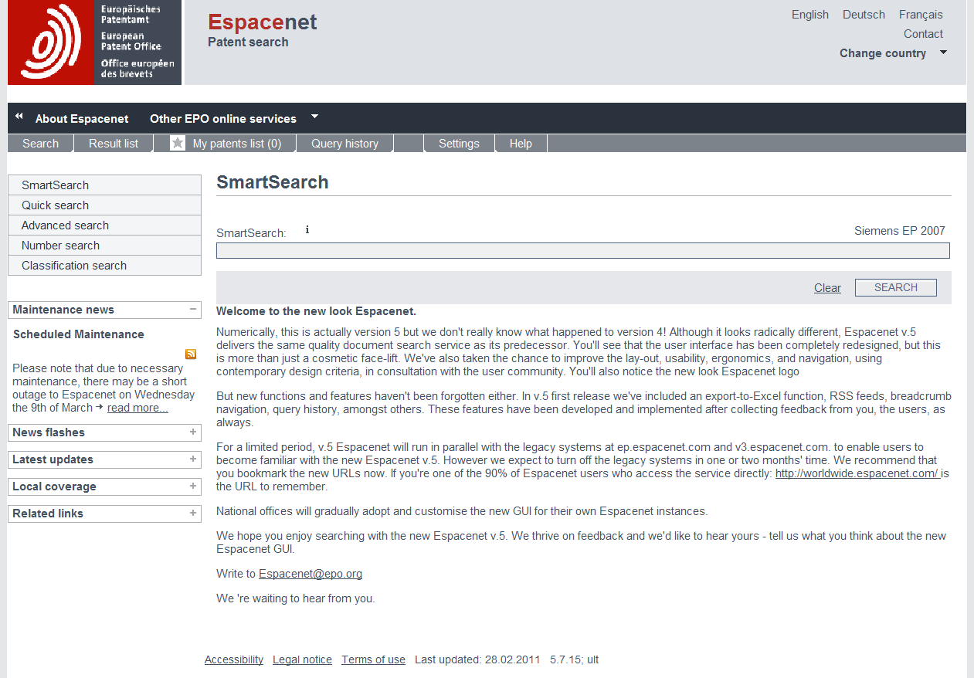
Searching for patents can be easy ...
Free worldwide patent information is available at
http://worldwide.espacenet.com/

Slide 30
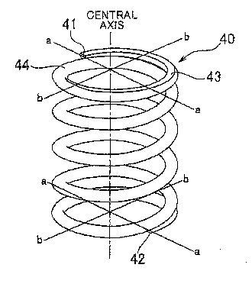
… but some basic knowledge is needed!
Beware of "naïve" keyword searches such as ...
Spring
"Energy storing means"

Slide 31
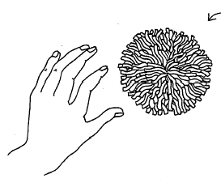
Sometimes, the applicant simply doesn't want his patent to be found …
Toy ball
"Spherical object with floppy filaments"

Slide 32
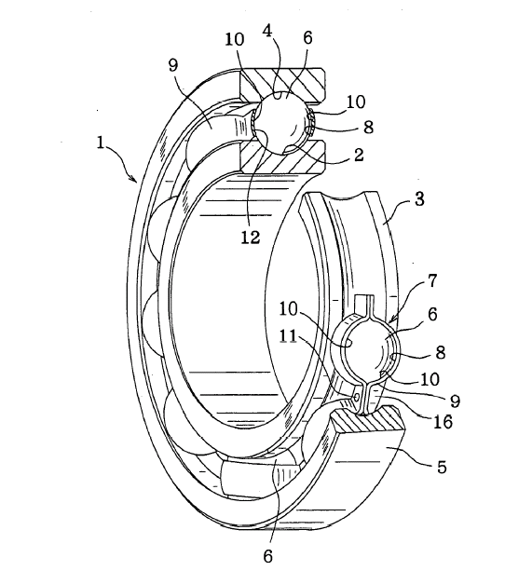
Sometimes, the applicant simply doesn't want his patent to be found …
Ball bearing
"A plurality of balls"

Slide 33
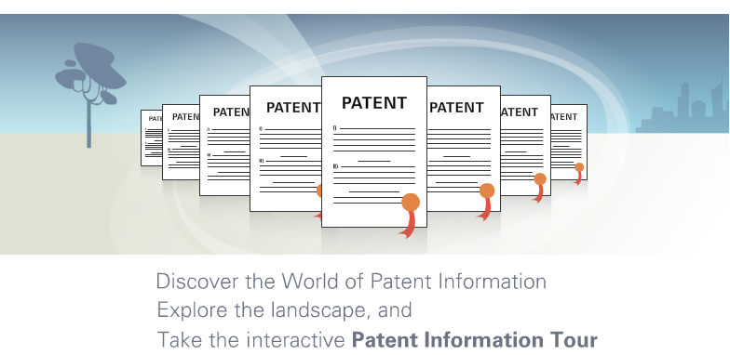
Find out how to search for patents!
www.epo.org/wbt/pi-tour
www.epo.org/patents/learning/e-learning.html

Slide 34
Βιβλιογραφία
EPO/OHIM, Intellectual Property Teaching Kit.
Οργανισμός Βιομηχανικής Ιδιοκτησίας, 2016, «Το εγχειρίδιο της διανοητικής ιδιοκτησίας.
Σαμουηλίδης Μ., 2014, «Δικαιώματα Διανοητικής Ιδιοκτησίας και Εκμετάλλευση Ερευνητικών Αποτελεσμάτων», έκδοση Μονάδας Καινοτομίας και Επιχειρηματικότητας http://mkentua.gr/wp-content/uploads/%CE%94%CE%B9%CE%BA%CE%B1%CE%B9%CF%8E%CE%BC%CE%B1%CF%84%CE%B1-%CE%94%CE%B9%CE%B1%CE%BD%CE%BF%CE%B7%CF%84%CE%B9%CE%BA%CE%AE%CF%82-%CE%99%CE%B4%CE%B9%CE%BF%CE%BA%CF%84%CE%B7%CF%83%CE%AF%CE%B1%CF%82_%CE%A3%CE%B1%CE%BC%CE%BF%CF%85%CE%B7%CE%BB%CE%AF%CE%B4%CE%B7%CF%82.pdf
Χρήσιμα links
www.wipo.int
https://www.obi.gr/obi/

