Slide 1
The Culture as the main sector of Social economy / Social Entrepreneurship against social Exclusion.
Case Study: The cultural activities of Athens’ Municipality
Pantazopoulos Stavros
Msc Management of Cultural Organizations
Greek Open University Supervisor: Professor Eugenia P. Bitsani

Slide 2
Questions to be answered
How is Social Economy linked to Social Exclusion and Culture?
What are the social implications of Culture? What is the role of Culture in times of economic crisis?
What are Good Practices from other European countries that use Culture as a tool for responding to various social phenomena?
What are the strategies that can be developed through Culture in order to prevent Social Exclusion?
Can social exclusion only be prevented by cultural actions?

Slide 3
Definitions
Social Economy: the set of economic, business, productive and social activities undertaken by legal entities or associations of whom the constitutional purpose is the pursuit of collective benefits and serving general social interests (Law 4019/2011).
Social Entrepreneurship: the economic activity that provides new productive models of delivering products and services that serve the immediate human needs of the poorest sections of society that remain uncovered by today's economic and social structures (Seelos και Mair, 2005).
Social Capital: the networks of relationships among people who live and work in a particular society, enabling that society to function effectively (Bitsani, 2013).

Slide 4
Social Economy and entrepreneurship in Greece
The first law on Social Economy was introduced in 2011 (Law 4019/2011) and provided the first institutional framework for the development of social enterprises.
Law 4019/2011 allows the establishment of Social Cooperative Businesses, which is a new body of the aforementioned Social Economy. Basically, it is an enterprise with a social purpose and legally a commercial property.
The Social Cooperative Businesses is equally owned by its members and its function is based on the pursuit of collective benefit while its profit derives from actions that serve exclusively the social interest.
In 2016, Law 4430/2016 was introduced. Attempts to regulate the operation of the Social and Solidarity Economy in the country. Aims at an institutional reconstruction and a creation of collective and social benefits.

Slide 5
Culture and Social Economy
Culture is at the heart of sustainable development policies, whether this is economic, environmental or social, as it offers to European societies the ability to develop solutions to economic, immigration, environmental and demographic problems.
Culture contributes substantially to increasing employment, investing in research and innovation, saving energy resources, improving education, combating poverty and social exclusion. It creates networks because of its interconnection with a variety of industries and services, including cultural-creative industries and cultural tourism.

Slide 6
Culture and Social Economy-2
The use of cultural goods also affects the real economy. A dynamic is created in the treatment of cultural goods, stemming from a holistic and balanced view of the natural and cultural environment, supporting a sustainable development model.
In general, culture is a pillar of a strategic cultural development in connection with the promotion of entrepreneurship with a social dimension. The contribution of culture to the social economy, recruits essential characteristics as it offers to the social cohesion.

Slide 7
Social Exclusion and Culture
The European cultural policy against the Social Exclusion is pioneering.
Greek cultural policy is inextricably linked to the European one.
In times of economic as well as social crisis, culture can be a motive for social development.
Ethical contribution to society.
Employability that civilization can provide to citizens by creating an entire industry, both at national and regional level.
Participating in cultural actions leads citizens to be more active, helps to create a sense of supply and utility, develops volunteerism, and leads groups of people excluded from social action to become part of society. Such activities include sports clubs, local amateur theaters, clubs and local bodies.

Slide 8
Cultural Activities Combating Social Exclusion in Greece
Arts for Social Development - «Atrides: Book Reviews.
Intercultural Program: "Crossroads of Art" was implemented under the 2013 Annual Program of the European Fund for the Integration of Third-Country Nationals ", Action 1.4.a / 13: Crossroads of Art.
The project "Video life stories of migrants", which was produced during the two years 2012-2013.
From 2011 and for four years, the Amaka NGO, together with POLYPLANITY and the SYNERGY-O theater, have organized the action "STATION ATHENS".
The "Schools for Change - Non-Typical Human Rights Education Activities in Primary Schools and High Schools" program took place during the period 2012 - 2013, and continues to this day, voluntarily, in Thessaloniki and in cities of Macedonia, Antigone".
The Dialogue Program was developed by the interdisciplinary group "Polydromo" and the TEEPE of the Aristotle University of Thessaloniki.

Slide 9
Cultural Activities Combating Social Exclusion in Greece-2
The Greek-Arabic project (2011) promoted contact between the two cultures, Greek and Arabic, and their languages ​​in Greece, with the aim of rebuilding knowledge about Arabic language and culture and the elimination of stereotypes of young learners.
Through the "VIEW N'ACT" project, several organizations from different countries, co-ordinated by CYCLISIS, have developed a framework that deals with the film as a pedagogical tool in Adult Education.
The program "Training of teachers and members of the educational community" lasted for five years, from 2010 until 2014. This period supported schools with multicultural composition of student population.

Slide 10
Best Practices from EU
Discover Culture was developed in Germany in 2011-2012.
The "Get up, move yourself!" Program that ran from 2010 to 2013 in the city of Solingen, Germany.
The Cultural Adequation Program, which was drafted in Sofia, Bulgaria between 9/2013 - 9/2014, was addressed to refugees and asylum seekers.
The SOKULTURA program aimed to promote the culture of minorities in Slovenia, as well as to enhance the employment of members of the Immigrant Communities in the field of Culture.
Also in Slovenia, the "World Dolls" program took place between 2013 and 2014. The main objectives of the program were to increase the employability of people belonging to vulnerable groups with training in puppet and global learning techniques.

Slide 11
Cultural activities combating Social Exclusion from the Municipality of Athens
“Four Arts, a Dream". This event was held in cooperation with the Spasticity Protection Society. It concerned free delivery of dance, music and painting lessons to children, young people and adults facing disability problems.
The Skin to Live Exhibition of Art Photography took place at the Cultural Center of the City of Athens all in October 2015. The aim of the exhibition was to dissect the patients with severe skin diseases of urticaria and psoriasis.
Within the framework of the Artistic program, the Artistic Festival was organized by the Society for Spasticity Protection in cooperation with the Municipality of Athens. Its goal is to remove any form of UA.
In 2014, the Municipality of Athens organized the event "A fifteen minute dramatized poetry from the collection" In the poetry "of Titus Patrikios", presented by the theatrical group of homeless people of the Center of Reception and Solidarity of the Municipality of Athens.

Slide 12
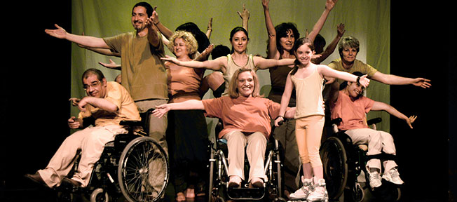
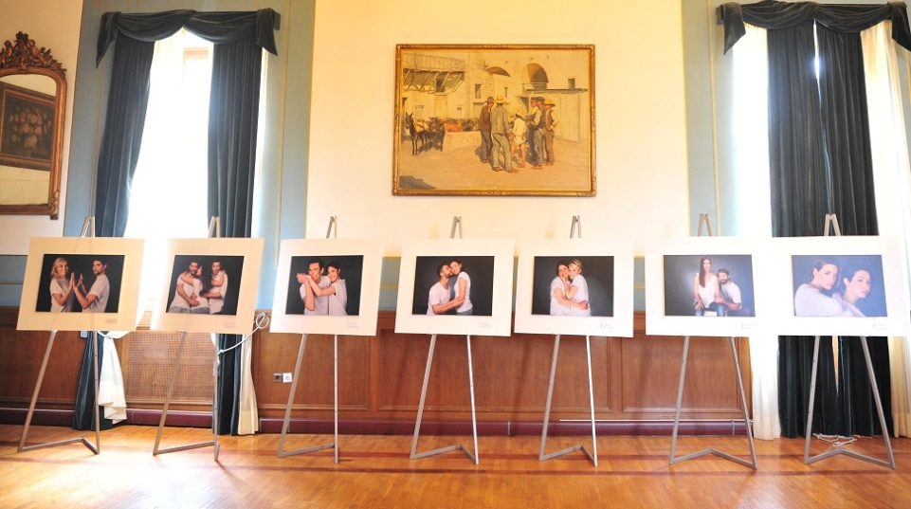
Cultural activities combating Social Exclusion from the Municipality of Athens-2
«Four Arts, a Dream“
«The Skin to Live Exhibition
of Art Photography»

Slide 13
Cultural activities combating Social Exclusion from the Municipality of Athens-3
In collaboration with a TV channel, organized a concert at the beginning of the year to collect food. Instead of a ticket, the citizens attending the concert offered long-lasting food, which was given to the "City of Athens Reception and Solidarity Center".
An important action by the City of Athens is also the organization of the long-standing "Live Books" event, in collaboration with the Live Library team. The action takes place in the Library of the City of Athens. Books are not read, but people echo their experiences about discrimination, prejudice, racism and the CA they have experienced.
The "Immigrant Coexistence Cup" is an annual football tournament among migrant groups living in Greece. It is organized by the City of Athens with the aim of eliminating racial discrimination and lifting the CA of immigrants.

Slide 14
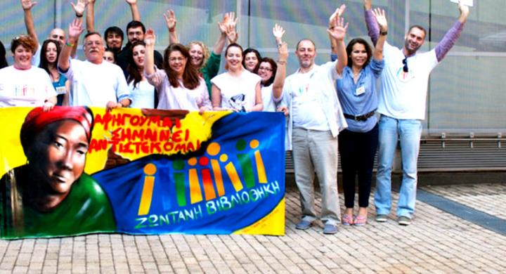
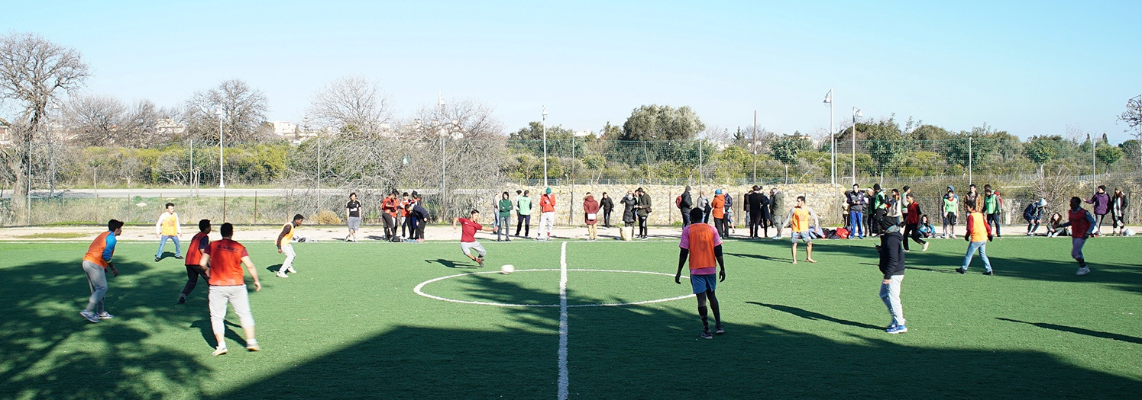
Cultural activities combating Social Exclusion from the Municipality of Athens-4
«Live Books»
«Immigrant Coexistence
Cup»

Slide 15
Conclusions
How is Social Economy linked to Social Exclusion and Culture?
Culture contributes substantially to increasing employment, investing in research and innovation, saving energy resources, improving education, combating poverty and social exclusion. It creates networks because of its interconnection with a variety of industries and services, including cultural-creative industries and cultural tourism

Slide 16
Conclusions-2
What are the social implications of Culture? What is the role of Culture in times of economic crisis?
As mentioned above, culture is a structural component of societies. Ιt is a coherent component between people and groups with different characteristics. At the same time, culture can help tighten human relationships through participation and, at a later stage, eliminate those elements that separate people and create divisive social influences.

Slide 17
Conclusions-3
Can social exclusion only be prevented by cultural actions?
Social exclusion is a phenomenon and at the same time, a problem of all societies around the world. However, the reconciliation of culture, social economy and social entrepreneurship can develop a bond between society and real economy, can enhance the cultural industry and finally, can provide job opportunities to people who suffer from all kinds of social exclusion.

